Slide 1
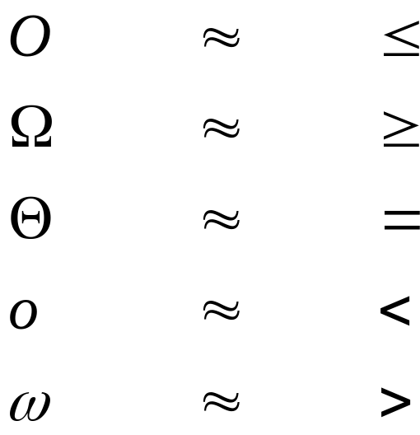
Chapter 3 Growth of functions--overview
Formal definitions of notation

Slide 2


O-notation
O( g (n ))={f (n) : there exist positive constants c and such that
g(n) is an asymptotic upper bound for f (n)
If we write f (n) =O(g (n ))

Slide 3
Example

Slide 4

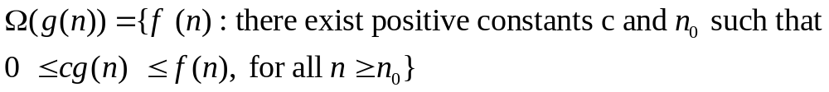
notation
g(n) is an asymptotic lower bound for f (n) .

Slide 5
Example

Slide 6

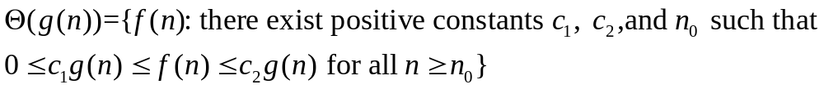
notation
g(n) is an asymptotically tight bound for f (n).
Theorem:

Slide 7
Example

Slide 8

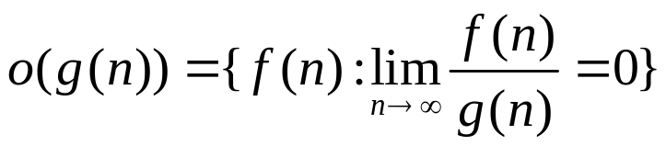
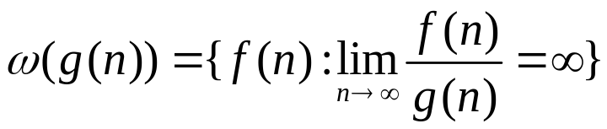
-notation and o-notation

Slide 9
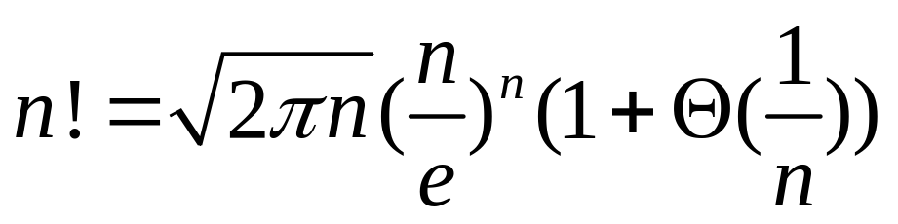
Stirling’s approximation
L’Hospital’s Rule

Slide 10
Ch 4 Divide & Conquer and Recurrence--Overview
Divide & conquer method
  Merge sort –done
  Matrix multiplication: two divide and conquer algorithms
    Straight forward method –
    Strassen’s method –
Recurrence: definition and how to solve
  Three methods
    Substitute
    Recursion tree
    Master method

Slide 11
Divide & Conquer
Three steps
  Divide
  Conquer
  Combine
Complexity:

Slide 12
Matrix multiply using divide & conquer--straight forward

Slide 13
Matrix multiply using divide & conquer-Stassen’s

Slide 14
Recurrence--Overview
A recurrence is an equation or inequality describing a function in terms of
  one or more base, and
  itself, with smaller inputs.
  example
  Express solution in asymptotic notation, not exact
How to solve recurrence
  substitution method
  recursion tree method
  master method

Slide 15
Two technical issues
Subproblem size: requirement to be integers =>floors and ceilings: ignored
Boundary conditions

Slide 16
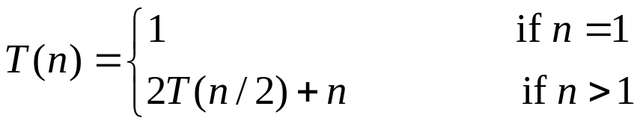
Substitution method
Guess the solution.
Use induction to show that the solution works.
Example:
1. Guess:
2. Induction:

Slide 17
Recursion trees
For the recurrence
Original problem: root with size n
Each non base node has a children with size n/b
By summing across each level, the recursion tree shows the cost at each level of recursion
Total cost= sum of all levels
Can be used to generate a guess. Then verify by substitution method.
Example
  Height of a tree
  Level:

Slide 18
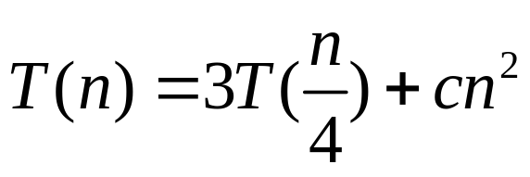

Construct the recursion tree
Height of the tree: level 0, 1,.., i,…,
#nodes in level i:
Cost of a node in level i: , cost of each level:
#of leaves
Total cost
Try n=16

Slide 19
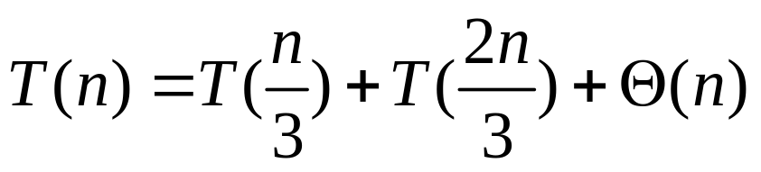

Slide 20
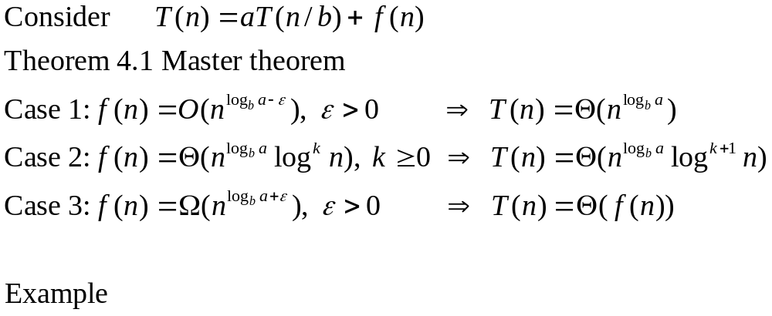
Master method

Slide 21
Summary of Chapter 4
Divide and conquer– Strassen’s matrix multiply
Three methods to solve recurrences
  Substitution
  Recursion tree
  Master method

